Slide 1

Presentation Title Here
aas

Slide 2
INTRODUCTION
In this project we have an ultrasonic sensor that measures the distance and an LED bar graph that lights up accordingly to our distance from the sensor. As we get closer to the sensor the buzzer beeps in a different way. This circuit can work as a parking sensor.

Slide 3

PARTS REQUIRED
Arduino UNO – read Best Arduino Starter Kits
1x 74HC595 8 Bit Shift Register
1x Breadboard
8x LEDs (for example: 3x red, 3x yellow, 2x green)
9x 220 Ohm Resistors
1x Buzzer
1x Ultrasonic Sensor (for example: HC-SR04)
Jumper Wires Schematics

Slide 4
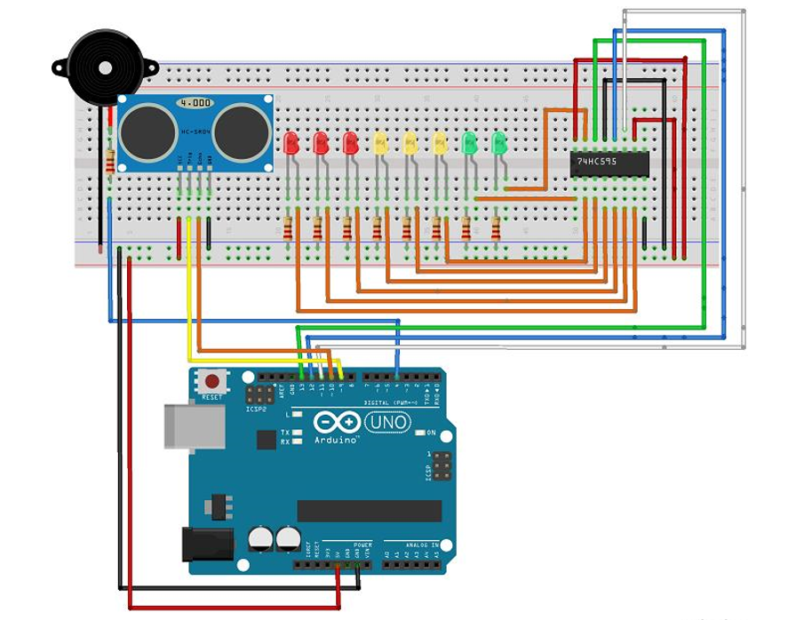
Schematics

Slide 5
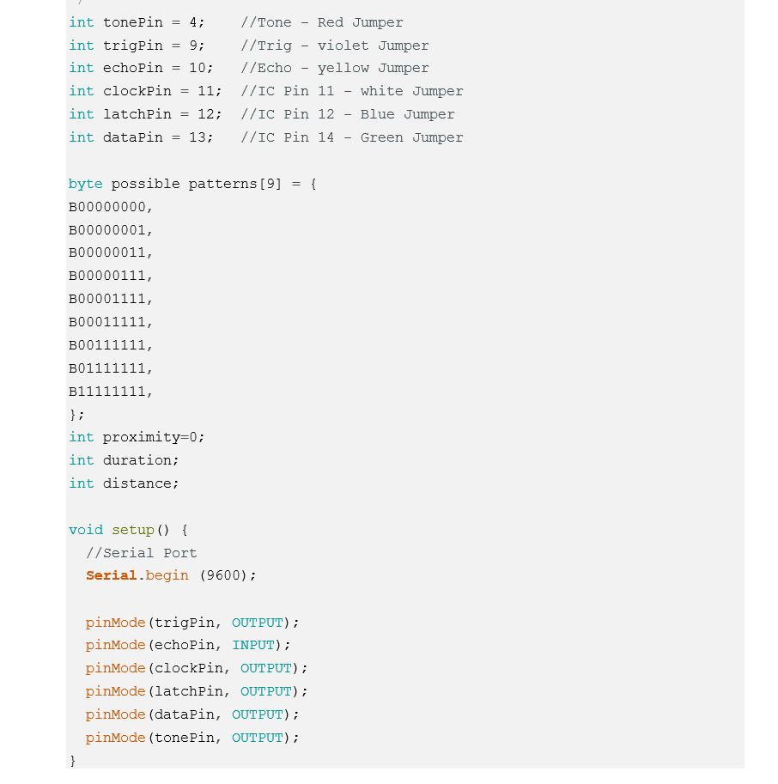
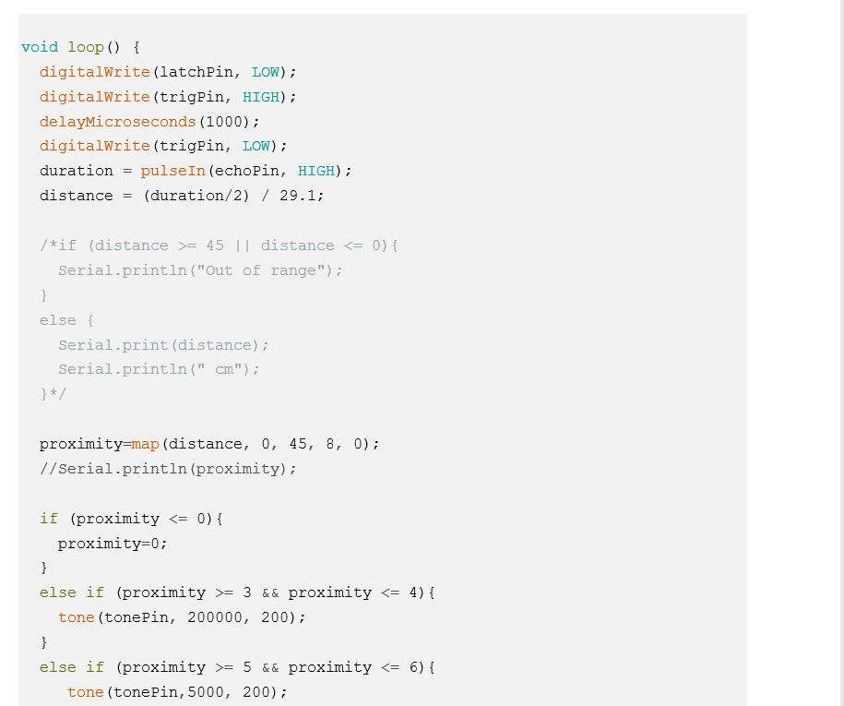
code

Slide 6
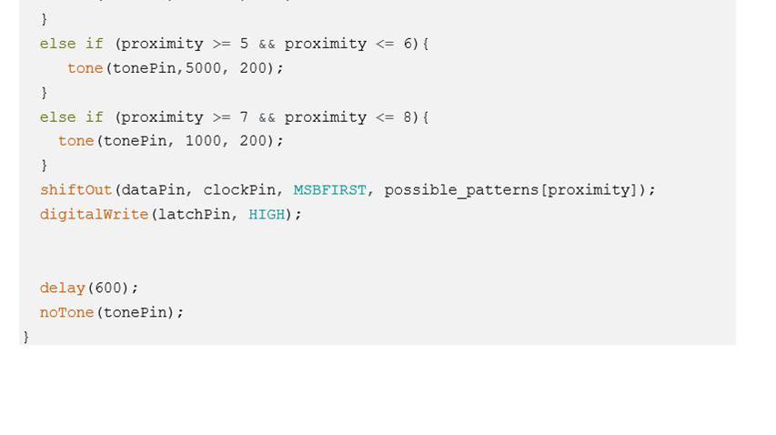

Slide 7
THANK YOU

